Slide 1
TEN POINTS FOR TIMBER ON TOP

Slide 8
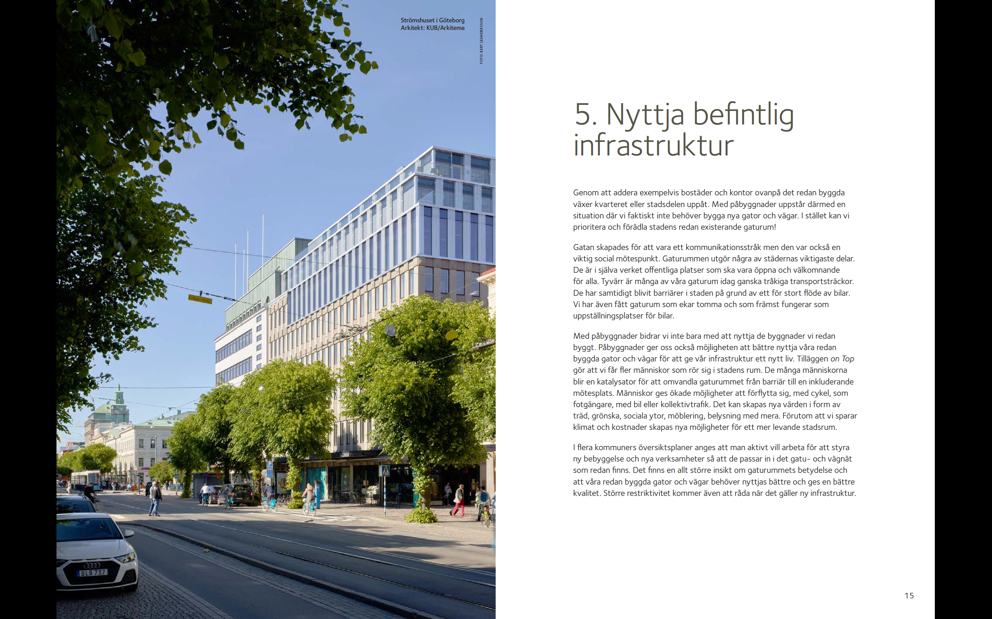

Slide 10
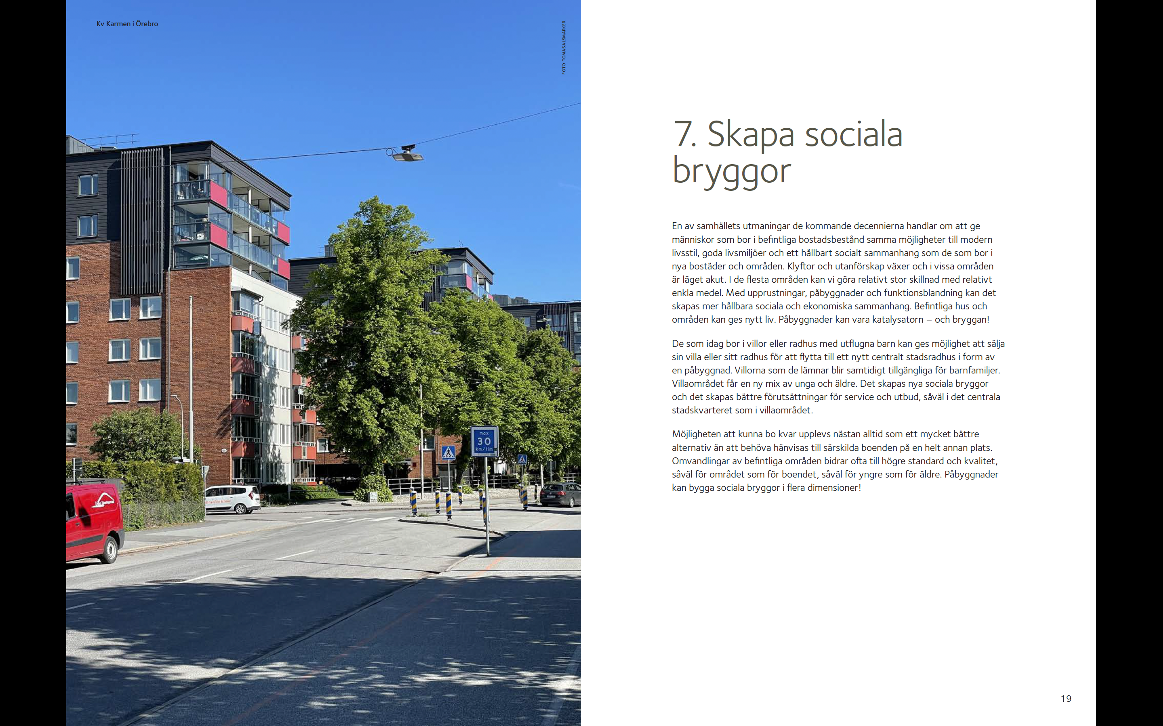

Slide 12
